Slide 1
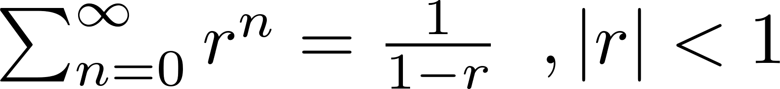
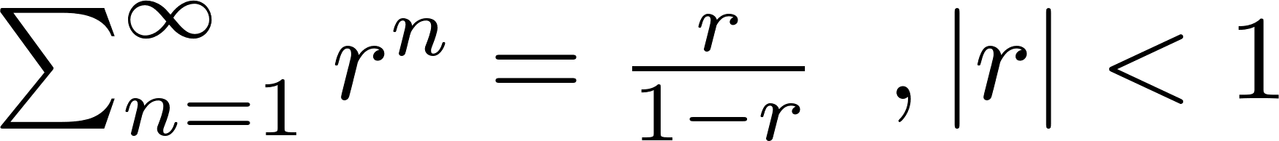
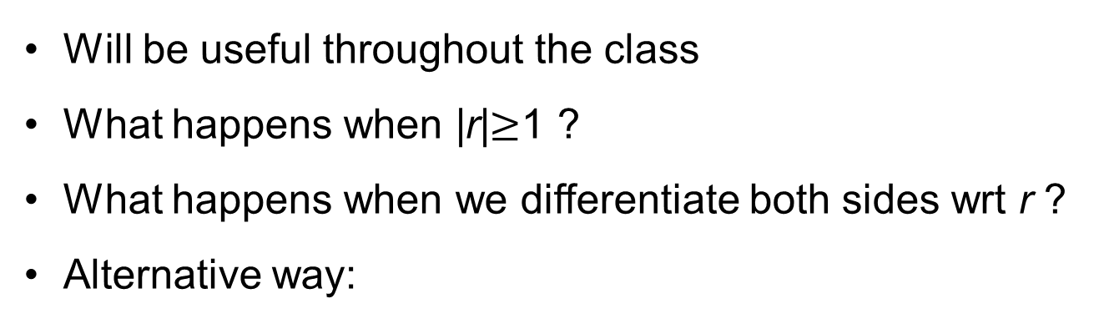
Geometric Sum Formula
Will be useful throughout the class
What happens when |r|$≥$1 ?
What happens when we differentiate both sides wrt r ?
Alternative way:

Slide 4
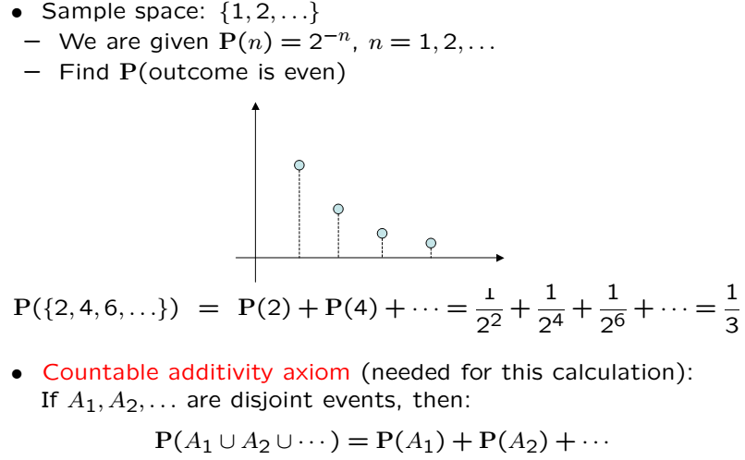
Countable Infinity

Slide 5

Countable Infinity Cont’
Can verify using the geometric sum formula (r=1/2)
Even outcome probability can be verified using same formula (r=1/4)

Slide 6
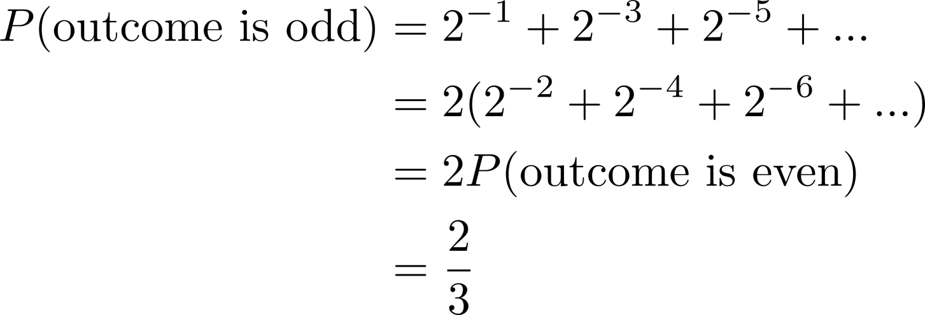
Odd Outcome Probability
Another way:

Slide 7
Acknowledgements and Citations
Parts of these slides are adapted from the following resources:
Power Point Lecture Slides for the Textbook http://bcs.wiley.com/hebcs/Books?action=index&bcsId=8676&itemId=1118324560
John Tsitsiklis. 6.041 Probabilistic Systems Analysis and Applied Probability, Fall 2010. (Massachusetts Institute of Technology: MIT OpenCourseWare),http://ocw.mit.edu (Accessed 13 Apr, 2015). License: Creative Commons BY-NC-SA

